Slide 1
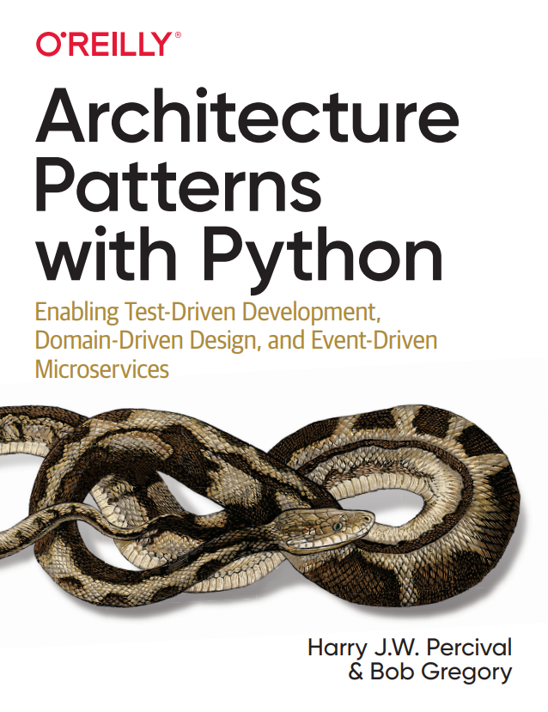

Slide 2
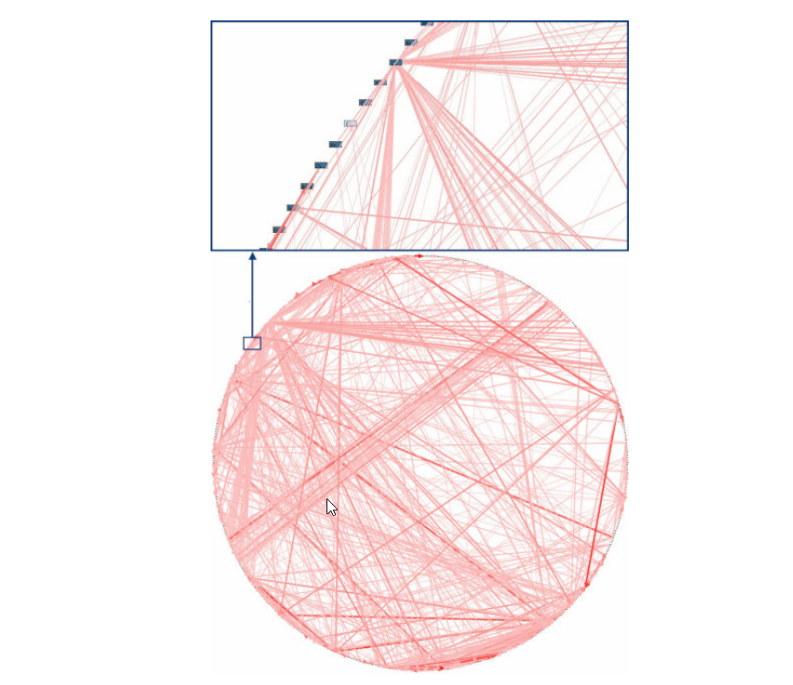
The Big Ball of Mud anti-pattern.

Slide 3
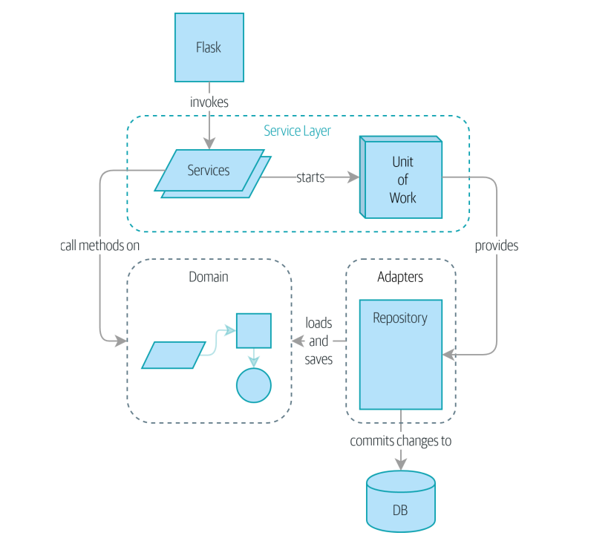
Where we’re going in part one of this book

Slide 4
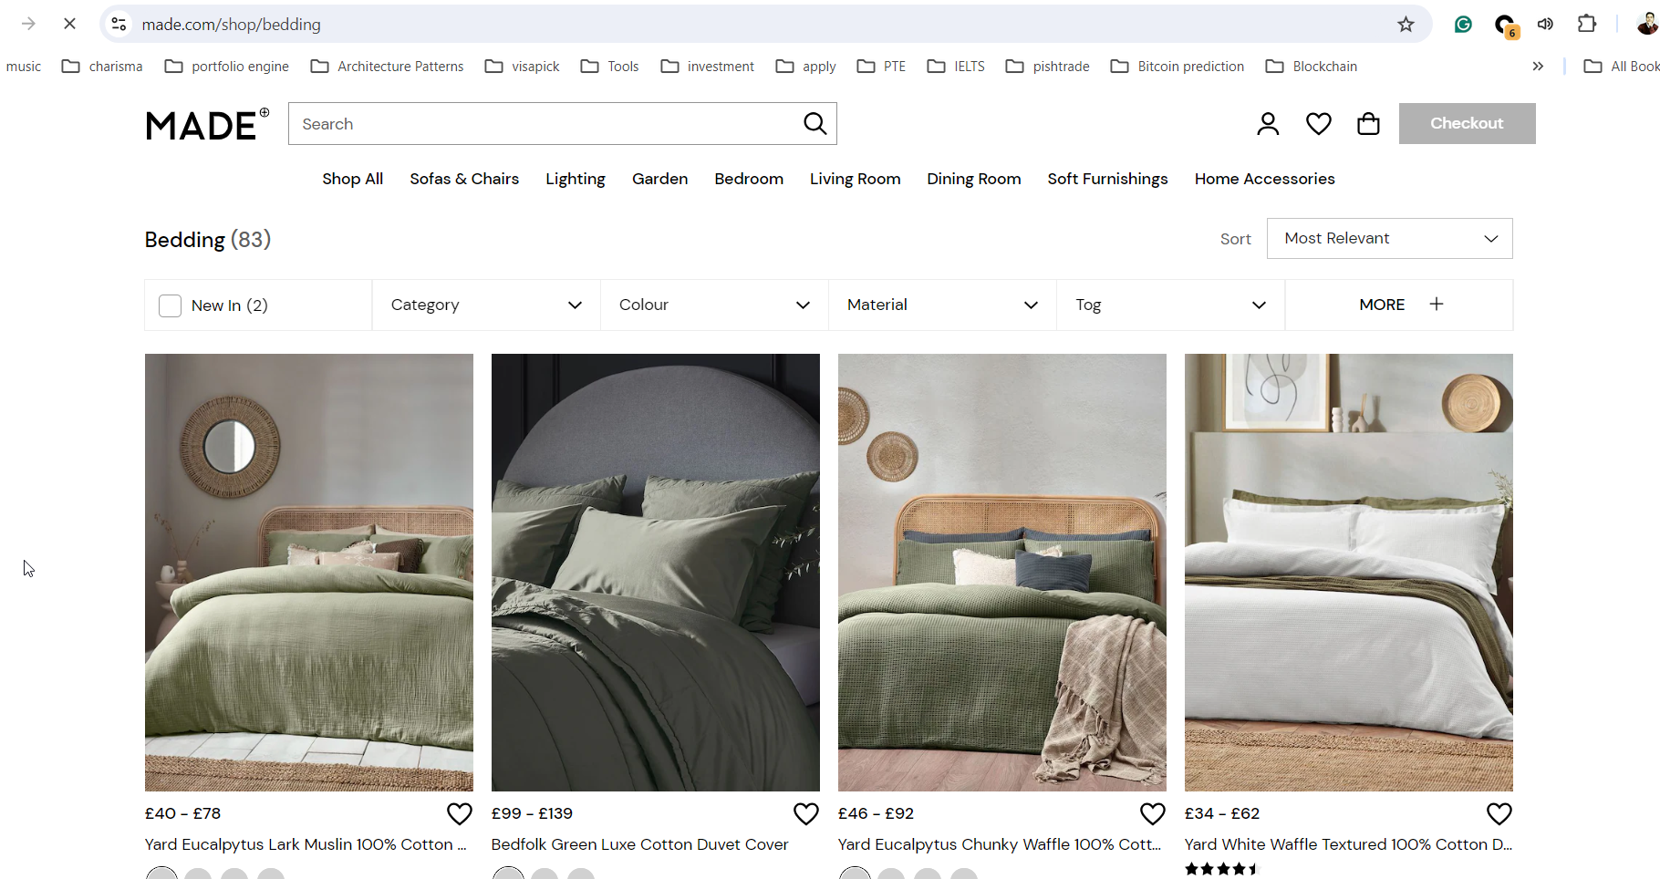
Chapter 1: Problem definition

Slide 5
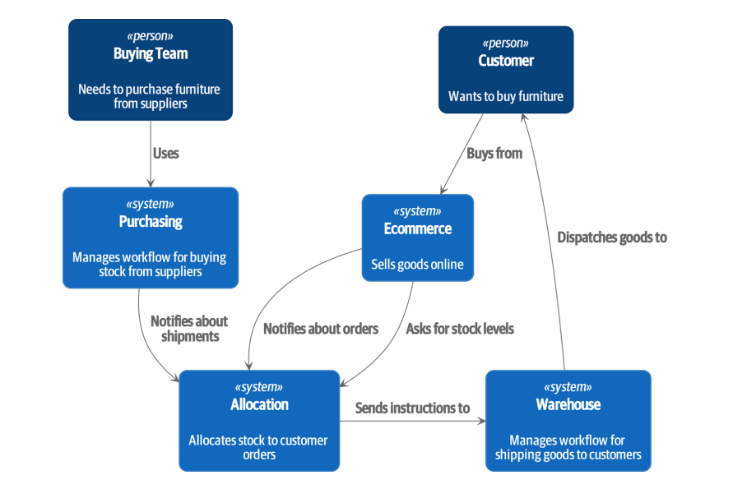
Chapter 1: Problem definition

Slide 6
Exploring the Domain Language
1- A product is identified by a SKU, pronounced “skew,” which is short for stock-keeping unit. Customers place orders. An order is identified by an order reference and comprises multiple order lines, where each line has a SKU and a quantity. For example: 10 units of RED-CHAIR
2- The purchasing department orders small batches of stock. A batch of stock has a unique ID called a reference, a SKU, and a quantity.
3- We need to allocate order lines to batches. When we’ve allocated an order line to a batch, we will send stock from that specific batch to the customer’s delivery address
4- We can’t allocate to a batch if the available quantity is less than the quantity of the order line
5- We can’t allocate the same line twice.

Slide 7
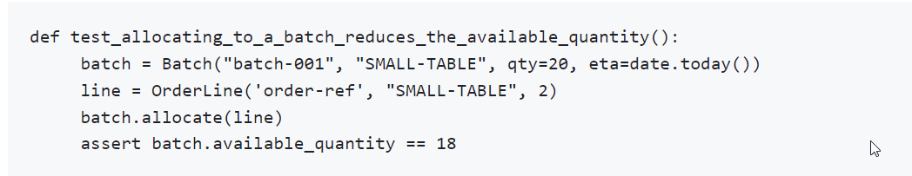
Unit Testing Domain Models

Slide 8
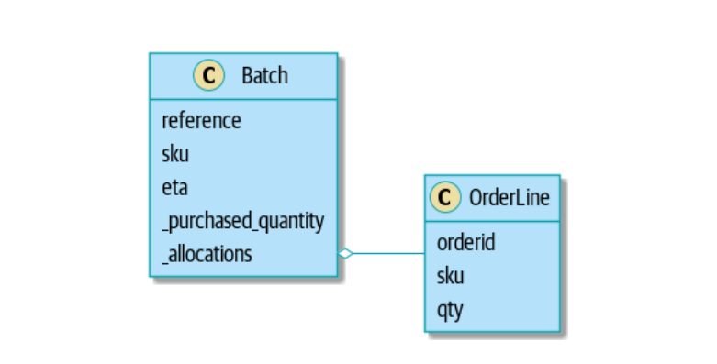
Here is our UML and domain model:
Link of the model in GitHub

Slide 9
Value Object and Entity
Whenever we have a business concept that has data but no identity, we often choose to represent it using the Value Object pattern. A value object is any domain object that is uniquely identified by the data it holds.
We use the term entity to describe a domain object that has long-lived identity. We can change their values, and they are still recognizably the same thing. Batches, in our example, are entities.

Slide 10
Not Everything Has to Be an Object: A Domain Service Function
A thing that allocates an order line, given a set of batches, sounds a lot like a function, and we can take advantage of the fact that Python is a multiparadigm language and just make it a function.
Python is a multiparadigm language, so let the “verbs” in your code be functions.
Link of the allocate service

Slide 11
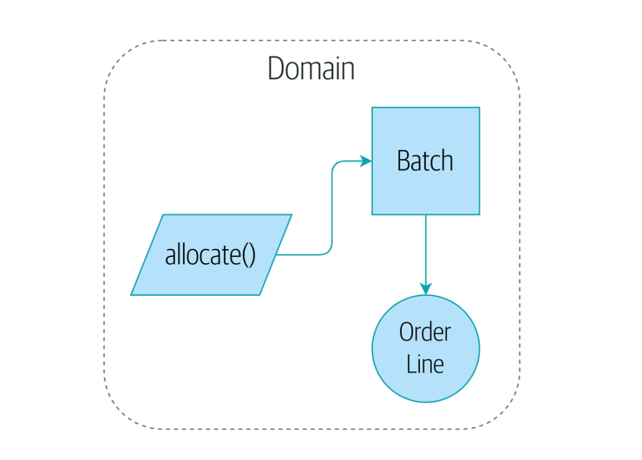
Figure below is a visual representation of where we’ve ended up.

Slide 12
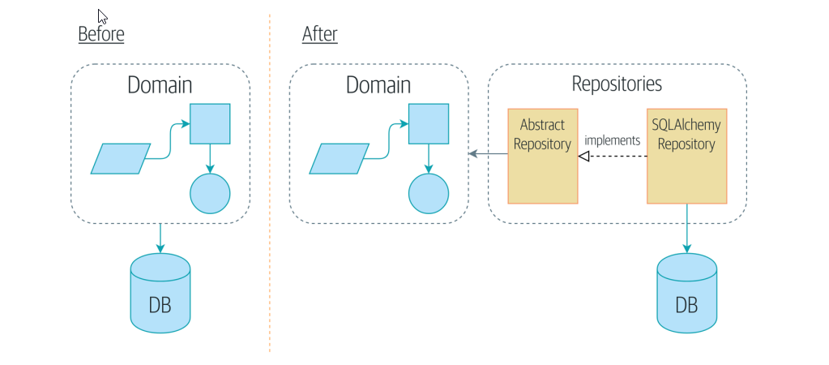
Chapter 2: Repository Pattern
We’ll introduce the Repository pattern, a simplifying abstraction over data storage, allowing us to decouple our model layer from the business layer (Dependency Inversion).

Slide 13
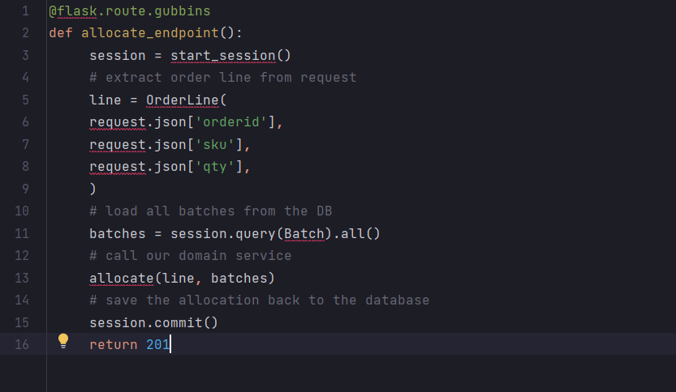
At this point, though, our API endpoint might look something like the following, and we could get it to work just fine: Using SQLAlchemy directly in our API endpoint

Slide 14
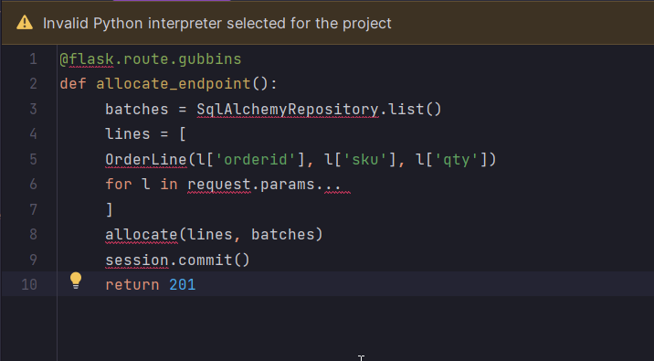
The Repository Pattern is a design pattern that acts as an abstraction layer between the data access layer and the business logic of an application. GitHub Link

Slide 15
Chapter 3: A Brief Interlude: On Coupling and Abstractions
Read about this chapter in the following Link: Chapter 3

Slide 16
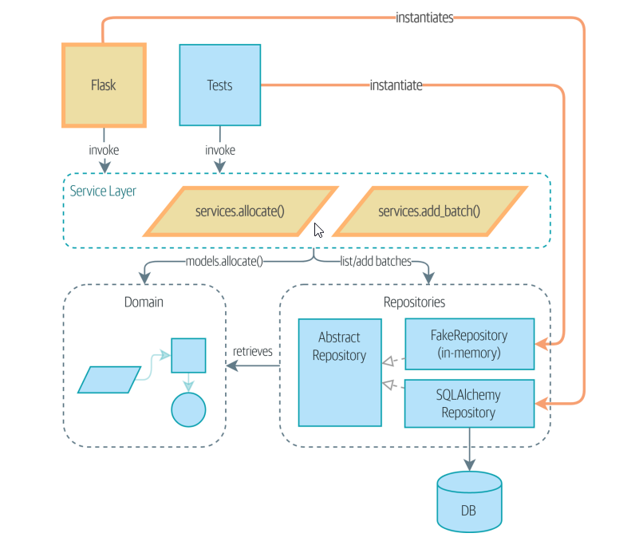
Chapter 4: Our First Use Case: Flask API and Service Layer

Slide 17
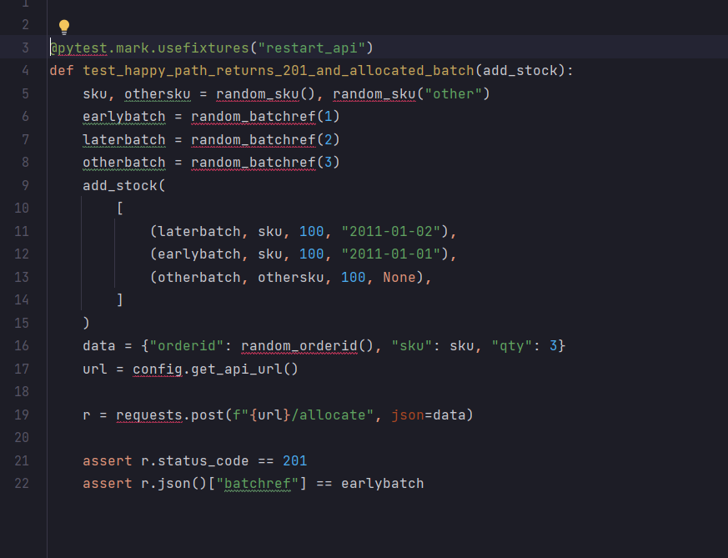
A First End-to-End Test

Slide 18
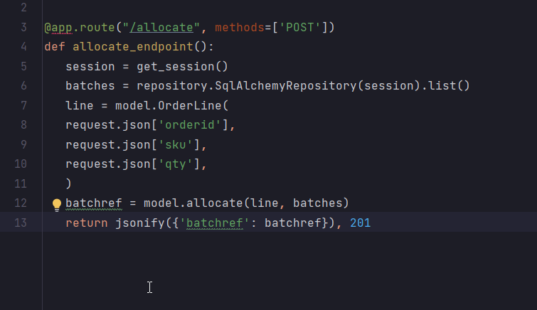
The Straightforward Implementation

Slide 19
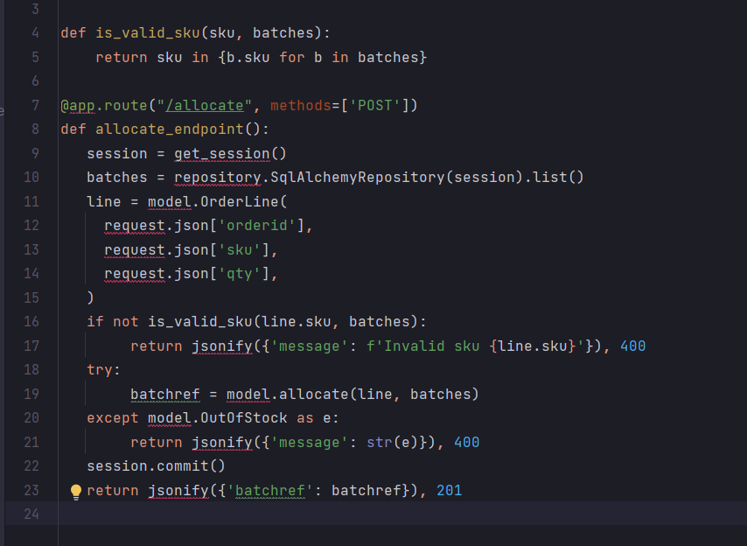
But if we want to add more error handling to this API it should be changed as below:

Slide 20
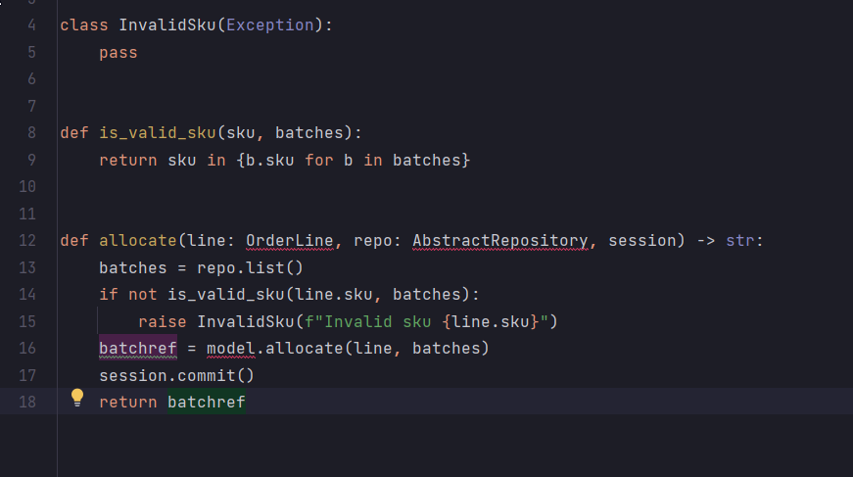
And finally we’ll write a service function that looks something like this (services.py):

Slide 21
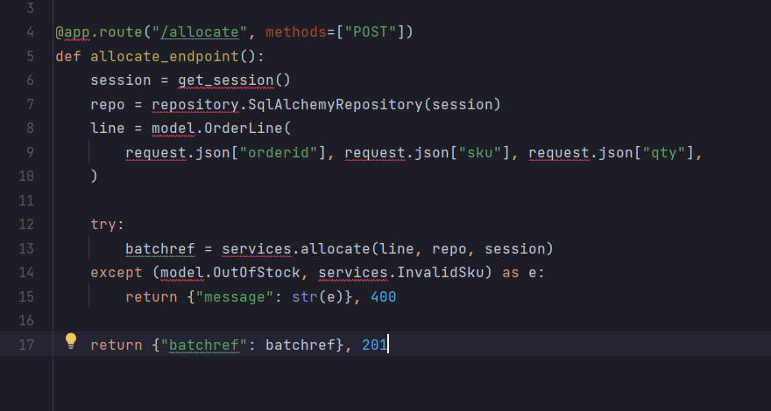
our Flask app now looks a lot cleaner:

Slide 22
The responsibilities of the Flask app are just standard web stuff: per-request session management, parsing information out of POST parameters, response status codes, and JSON.
All the orchestration logic is in the use case/service layer, and the
domain logic stays in the domain.

Slide 23
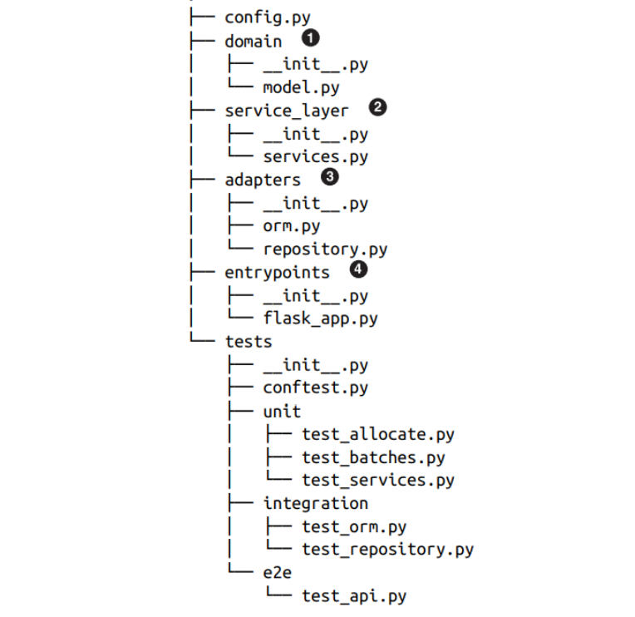

Slide 24
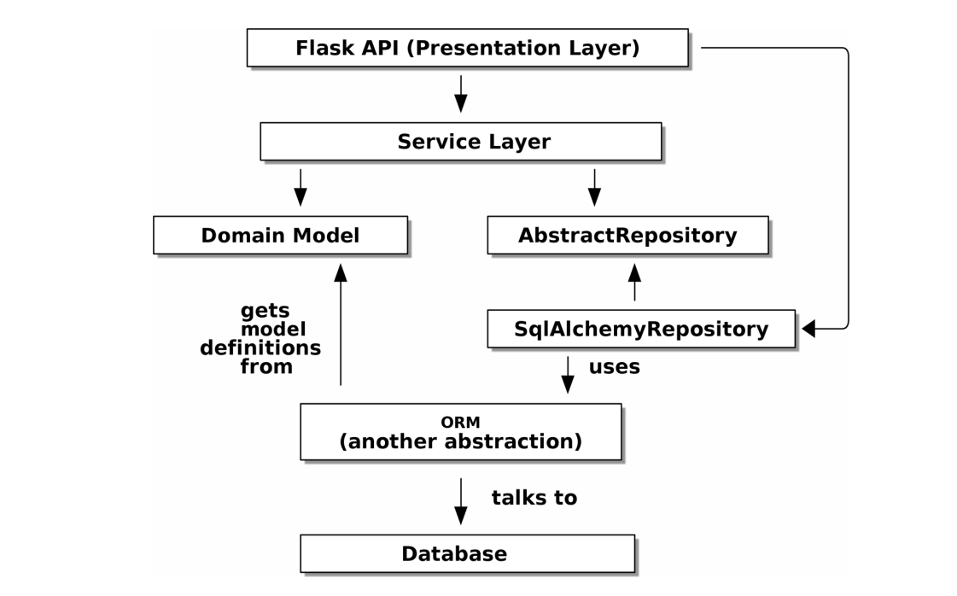
The DIP in Action GitHub

Slide 25
But there are still some bits of awkwardness to tidy up:
1- The service layer is still tightly coupled to the domain, because its API is expressed in terms of OrderLine objects. In Chapter 5, we’ll fix that and talk about the way that the service layer enables more productive TDD.
2- The service layer is tightly coupled to a session object. In Chapter 6, we’ll introduce one more pattern that works closely with the Repository and Service Layer patterns, the Unit of Work pattern, and everything will be absolutely lovely. You’ll see!

Slide 26
Chapter 5: TDD in High Gear and Low Gear
Tests are supposed to help us change our system fearlessly, but often we see teams writing too many tests against their domain model. This causes problems when they come to change their codebase and find that they need to update tens or even hundreds of unit tests.
As we get further into the book, you’ll see how the service layer forms an API for our system that we can drive in multiple ways. Testing against this API reduces the amount of code that we need to change when we refactor our domain model.

Slide 27
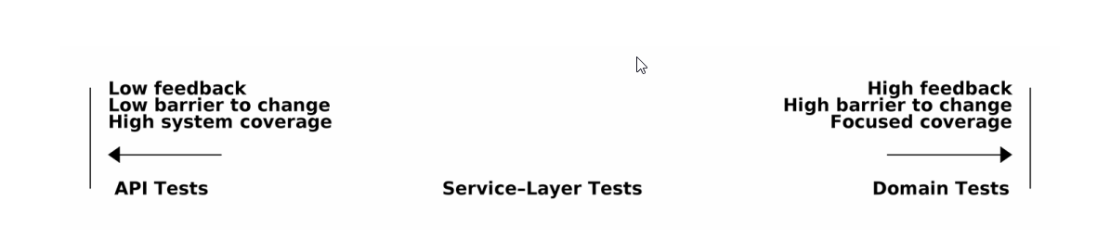
On Deciding What Kind of Tests to Write

Slide 28
High and Low Gear
The metaphor we use is that of shifting gears. When starting a journey, the bicycle needs to be in a low gear so that it can overcome inertia. Once we’re off and running, we can go faster and more efficiently by changing into a high gear; but if we suddenly encounter a steep hill or are forced to slow down by a hazard, we again drop down to a low gear until we can pick up speed again.

Slide 29
Chapter 6: Unit of Work Pattern
If the Repository pattern is our abstraction over the idea of persistent storage, the Unit of Work (UoW) pattern is our abstraction over the idea of atomic operations. It will allow us to finally and fully decouple our service layer from the data layer.

Slide 30
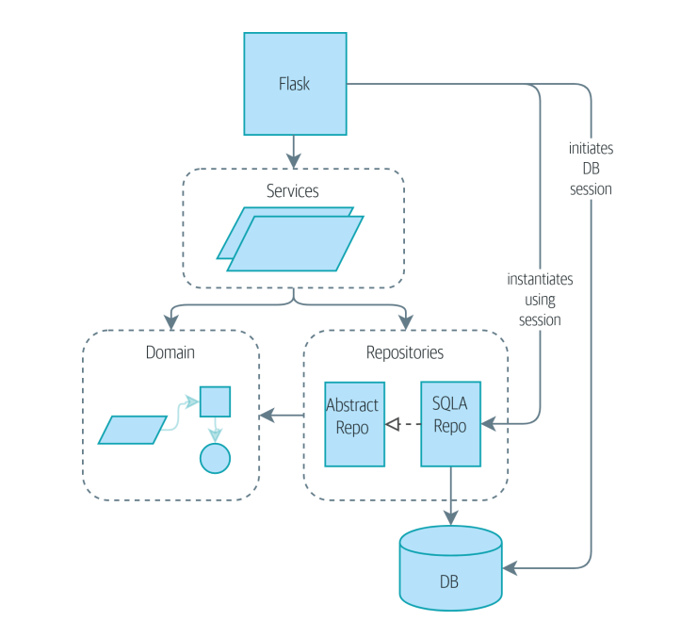
Without UoW: API talks directly to three layers

Slide 31
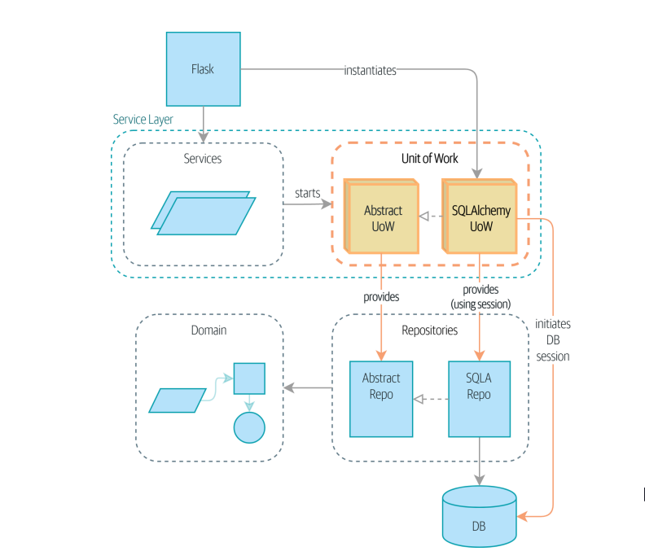
The Flask API now does only two things: it initializes a unit of work, and it invokes a service. The service collaborates with the UoW, but neither the service function itself nor Flask now needs to talk directly to the database.

Slide 32
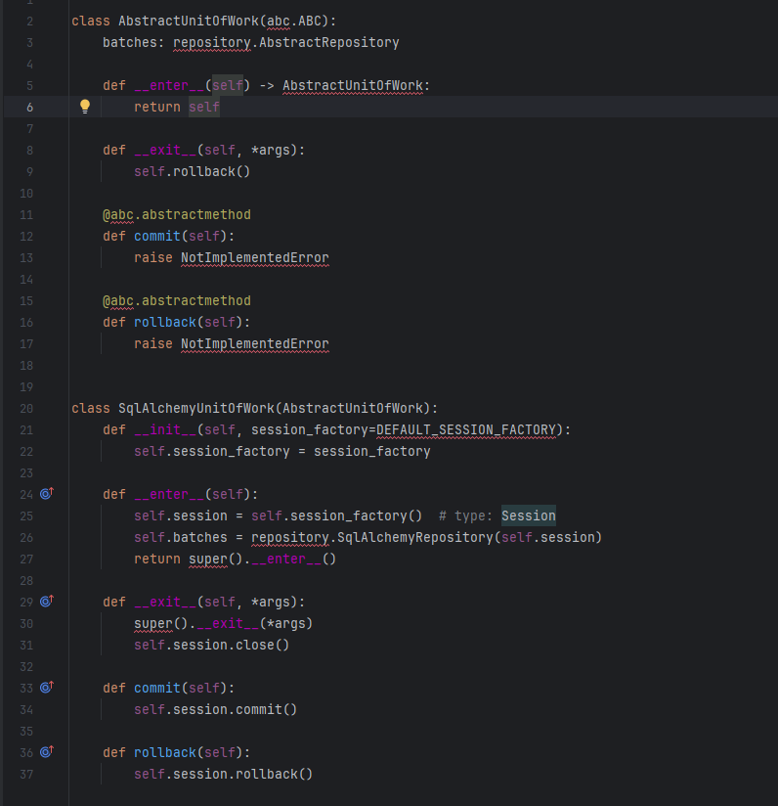

Slide 33
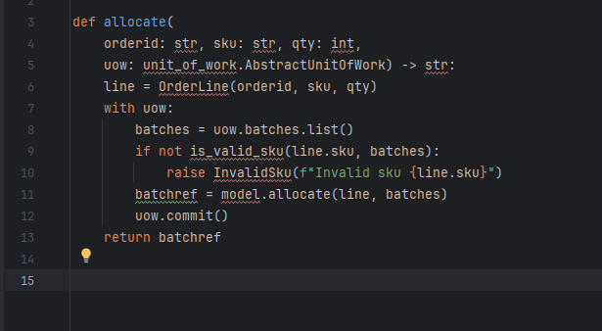
Here’s how the service layer will look when we’re finished
Our service layer now has only the one dependency, once again on an abstract UoW.

Slide 34
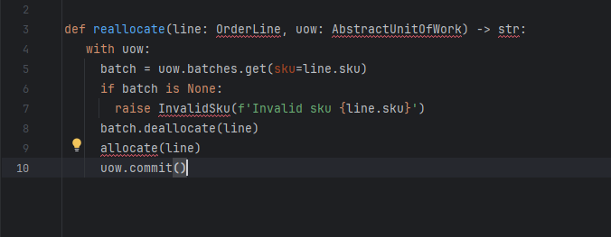
Examples: Using UoW to Group Multiple Operations into an Atomic Unit Suppose we want to be able to deallocate and then reallocate orders. If deallocate() fails, we don’t want to call allocate(), obviously. And, If allocate() fails, we probably don’t want to actually commit the deallocate() either.

Slide 35
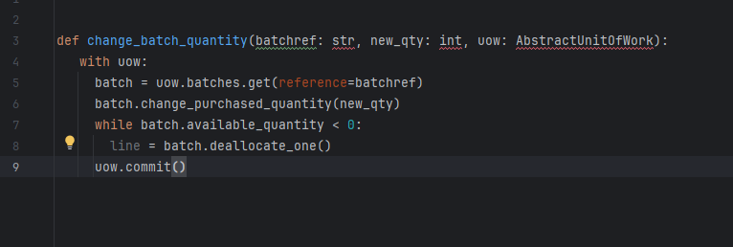
Example 2: Change Batch Quantity Our shipping company gives us a call to say that one of the container doors opened, and half our sofas have fallen into the Indian Ocean. Oops! Here we may need to deallocate any number of lines. If we get a failure at any stage, we probably want to commit none of the changes.
GitHub Link UOW

Slide 36
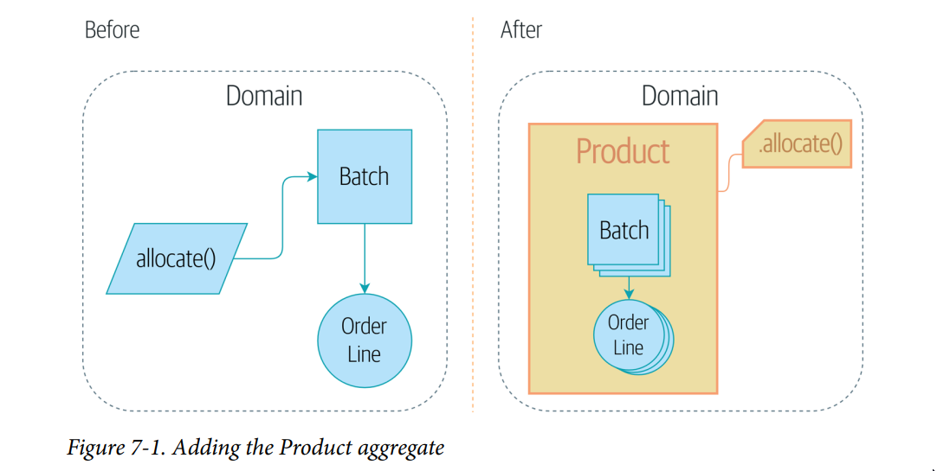
Chapter 7: Aggregates and Consistency Boundaries Figure below shows a preview of where we’re headed: we’ll introduce a new model object called Product to wrap multiple batches, and we’ll make the old allocate() domain service available as a method on Product instead.

Slide 37
Invariants, Constraints, and Consistency
constraint is a rule that restricts the possible states our model can get into, while an invariant is defined a little more precisely as a condition that is always true.
If we were writing a hotel-booking system, we might have the constraint that double bookings are not allowed. This supports the invariant that a room cannot have more than one booking for the same night
In a single-threaded, single-user application, it’s relatively easy for us to maintain this invariant. We can just allocate stock one line at a time, and raise an error if there’s no stock available. This gets much harder when we introduce the idea of concurrency. Suddenly we might be allocating stock for multiple order lines simultaneously. We usually solve this problem by applying locks to our database tables. This prevents two operations from happening simultaneously on the same row or same table.

Slide 38
What Is an Aggregate?
An aggregate is just a domain object that contains other domain objects and lets us treat the whole collection as a single unit.
For example, if we’re building a shopping site, the Cart might make a good aggregate: it’s a collection of items that we can treat as a single unit. Importantly, we want to load the entire basket as a single blob from our data store.
We don’t want two requests to modify the basket at the same time, or we run the risk of weird concurrency errors.
Each basket is a single consistency boundary responsible for maintaining its own invariants.
An AGGREGATE is a cluster of associated objects that we treat as a unit for the purpose of data changes. our aggregate has a root entity (the Cart) that encapsulates access to items. Each item has its own identity, but other parts of the system will always refer to the Cart only as an indivisible whole.

Slide 39
Simple Example: Shopping Cart
Consider a simple e-commerce system with a ShoppingCart aggregate. Here's how the aggregate ensures consistency:
ShoppingCart (Aggregate Root): Contains items, a total cost, and methods to add or remove items.
CartItem (Entity within Aggregate): Represents an individual item in the cart, including product details and quantity.
ProductID (Value Object): A unique identifier for a product.
Business Rule (Invariant): The total cost of the cart must always equal the sum of the costs of all items in the cart.

Slide 40
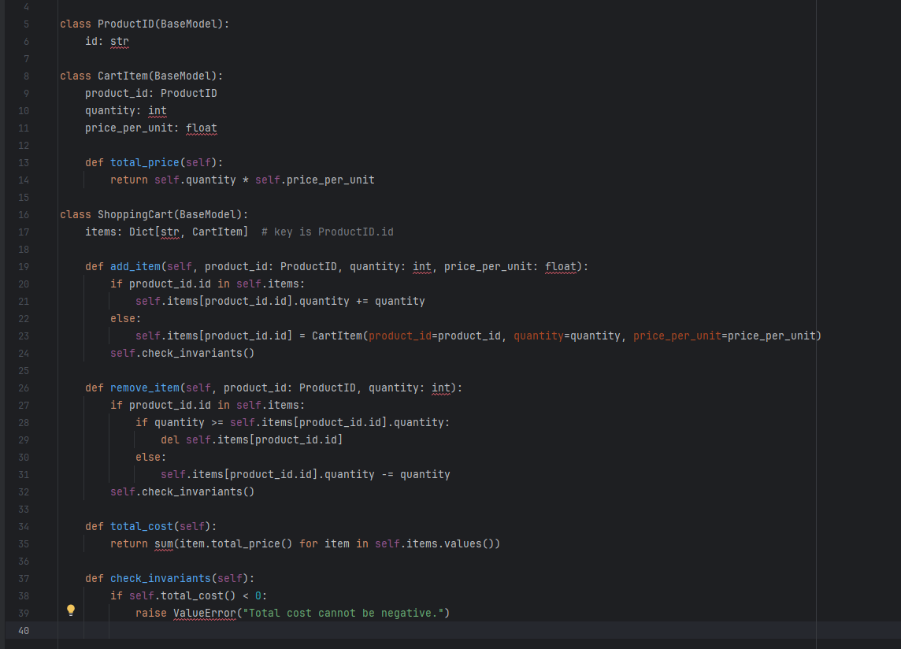

Slide 41
In this example:
1- The ShoppingCart class (aggregate root) manages all modifications to the cart's contents.
2- It ensures the invariant (total cost is correct) is maintained after any changes such as adding or removing items.
3- All interactions with CartItem objects go through the ShoppingCart, which controls and checks the consistency of its internal state. This model allows the application to maintain consistent rules about how products are added or removed, ensuring data integrity and business rule enforcement within the shopping cart system.
(According to the previous rule) only Aggregate Root can be directly retrieved from the database by Query. In other words, a Repository is defined for each Aggregate Root, and other objects cannot be retrieved directly and must be retrieved by the corresponding Aggregate Root. Also, direct access to save or edit an entity inside an Aggregate is meaningless, and database transactions are meaningful at the level of an Aggregate.

Slide 42
One Aggregate = One Repository
Once you define certain entities to be aggregates, we need to apply the rule that they are the only entities that are publicly accessible to the outside world. In other words, the only repositories we are allowed should be repositories that return aggregates.
In our case, we’ll switch from Batchepository to ProductRepository: GitHub Link
Here is our service layer: GitHub Link

Slide 43
Part I Recap

Slide 44
Part I Recap
We’ve decoupled the infrastructural parts of our system, like the database and API handlers This helps us to keep our codebase well organized and stops us from building a big ball of mud.
Lastly, we’ve talked about the idea of consistency boundaries. We don’t want to lock our entire system whenever we make a change, so we have to choose which parts are consistent with one another.
For a small system, this is everything you need to go and play with the ideas of domain-driven design. You now have the tools to build database-agnostic domain models that represent the shared language of your business experts. Hurrah!
If your app is essentially a simple CRUD wrapper around a database and isn’t likely to be anything more than that in the foreseeable future, you don’t need these patterns. Go ahead and use Django, and save yourself a lot of bother.

Slide 45
Event-Driven Architecture
In Part II, we’ll show how the techniques from Part I can be extended to distributed systems.
We’ll zoom out to look at how we can compose a system from many small components that interact through asynchronous message passing.
We’ll see how our Service Layer and Unit of Work patterns allow us to reconfigure our app to run as an asynchronous message processor

Slide 46
Chapter 8: Events and the Message Bus
Our example will be a typical notification requirement: when we can’t allocate an order because we’re out of stock, we should alert the buying team.
They’ll go and fix the problem by buying more stock, and all will be well.
For a first version, our product owner says we can just send the alert by email.

Slide 47
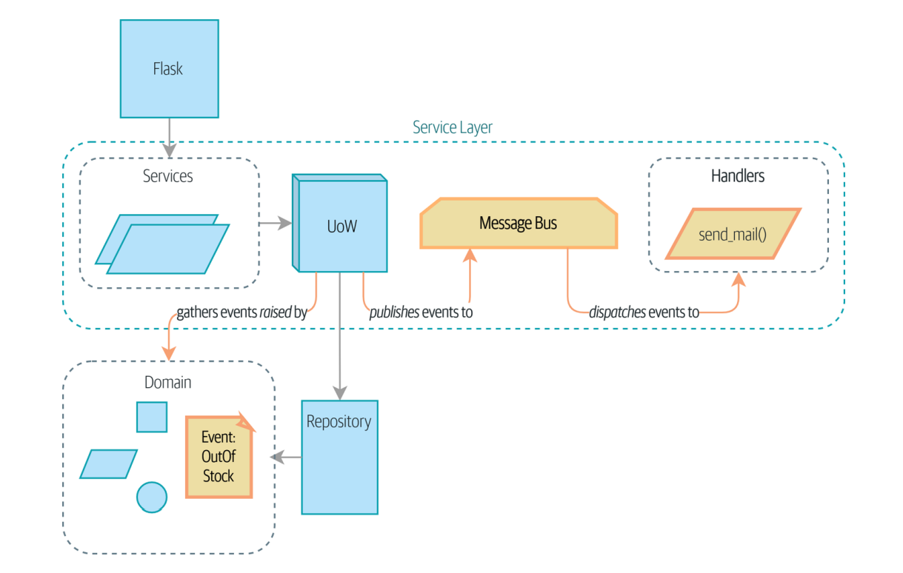

Slide 48
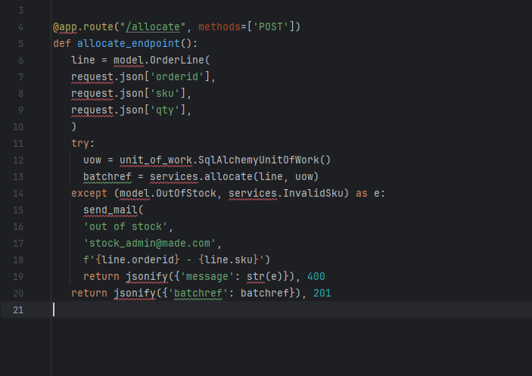
First, Let’s Avoid Making a Mess of Our Web Controllers
But Sending email isn’t the job of our HTTP layer, and we’d like to be able to unit test this new feature.

Slide 49
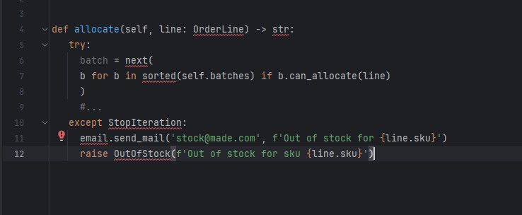
we may look at putting it right at the source, in the model
But that’s even worse! We don’t want our model to have any dependencies on infrastructure concerns like email.send_mail. The domain model’s job is to know that we’re out of stock, but the responsibility of sending an alert belongs elsewhere.

Slide 50
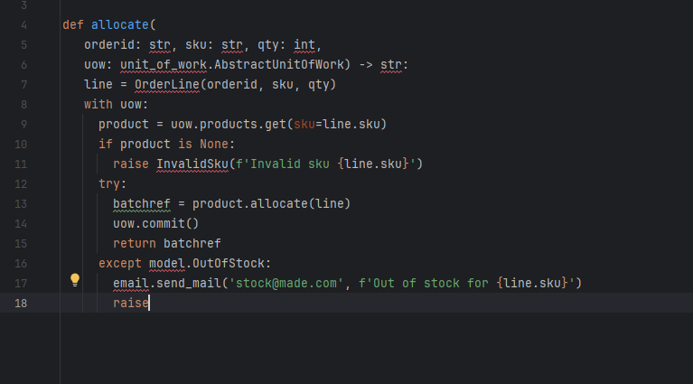
Or the Service Layer!
Catching an exception and reraising it? It could be worse, but it’s definitely making us unhappy. Why is it so hard to find a suitable home for this code?

Slide 51
Single Responsibility Principle
Rule of thumb: if you can’t describe what your function does without using words like “then” or “and,” you might be violating the SRP.
We should be able to turn this feature on or off, or to switch to SMS notifications instead, without needing to change the rules of our domain model.
We’d also like to keep the service layer free of implementation details

Slide 52
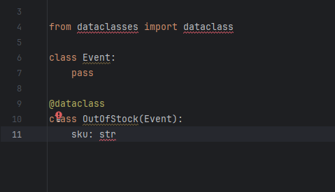
Domain Events and the Message Bus
An event is a kind of value object. Events don’t have any behavior, because they’re pure data structures. We always name events in the language of the domain, and we think of them as part of our domain model. We could store them in model.py, but we may as well keep them in their own file.

Slide 53
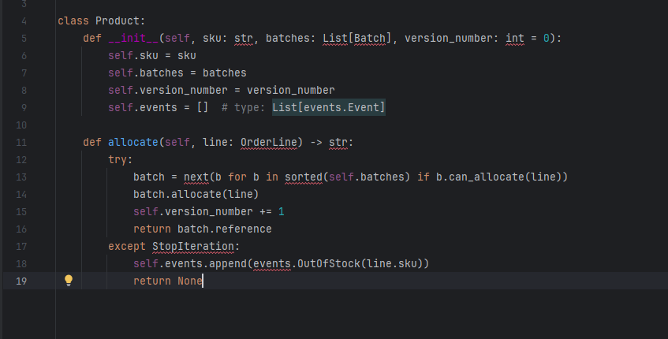
Our aggregate will expose a new attribute called .events that will contain a list of facts about what has happened, in the form of Event objects.

Slide 54
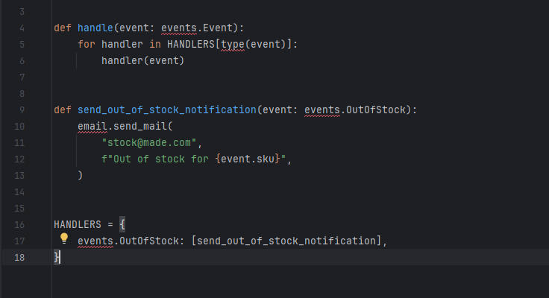
The Message Bus Maps Events to Handlers

Slide 55
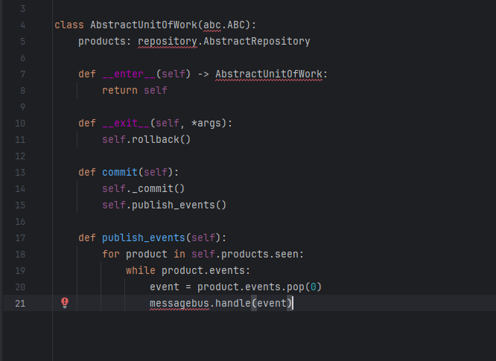
The UoW Publishes Events to the Message Bus
GitHub Link

Slide 56
Wrap-Up
Domain events give us a way to handle workflows in our system.
The magic words “When X, then Y” often tell us about an event that we can make concrete in our system.
Treating events as first-class things in our model helps us make our code more testable and observable, and it helps isolate concerns.
You can think of a message bus as a dict that maps from events to their consumers.
we can tidy up by making our unit of work responsible for raising events that were raised by loaded objects. This is the most complex design.

Slide 57
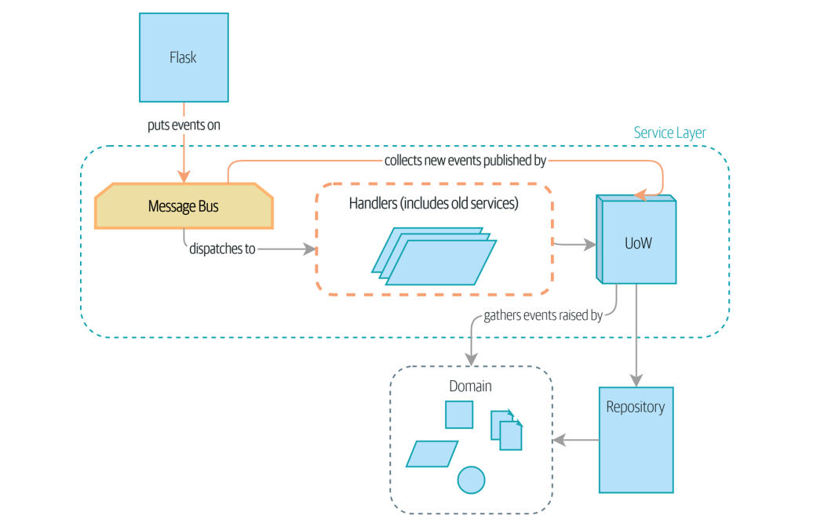
Chapter 9: Going to Town on the Message Bus We’ll move from the current state, where everything goes via the message bus, and our app has been transformed fundamentally into a message processor.

Slide 58
A New Requirement Leads Us to a New Architecture
Perhaps someone made a mistake on the number in the manifest, or perhaps some sofas fell off a truck. Following a conversation with the business we model the situation as in below.
An event we’ll call BatchQuantityChanged should lead us to change the quantity on the batch
if the new quantity drops to less than the total already allocated, we need to deallocate those orders from that batch.
Then each one will require a new allocation, which we can capture as an event called AllocationRequired

Slide 59
Imagining an Architecture Change: Everything Will Be an Event Handler
1- services.allocate() could be the handler for an AllocationRequired event and could emit Allocated events as its output.
2- services.add_batch() could be the handler for a BatchCreated event.
3- An event called BatchQuantityChanged can invoke a handler called change_batch_quantity().
4- And the new AllocationRequired events that it may raise can be passed on to services.allocate() too

Slide 60
Refactoring Service Functions to Message Handlers
We start by defining the two events that capture our current API inputs—AllocationRequired and BatchCreated. GitHub
we change all the handlers so that they have the same inputs, an event and a UoW GitHub
The Message Bus Now Collects Events from the UoW GitHub
Modifying Our API to Work with Events GitHub

Slide 61
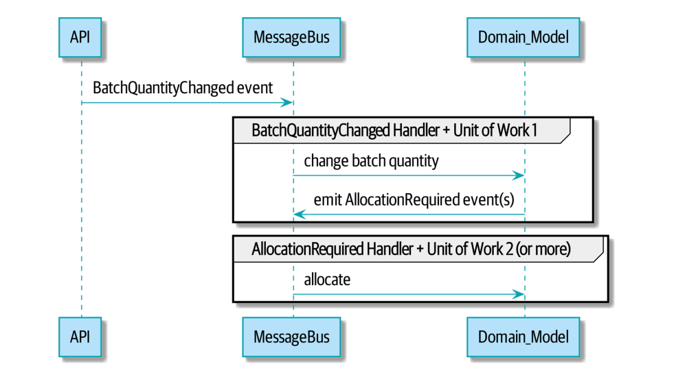
Implementing Our New Requirement

Slide 62
Implementing Our New Requirement
The event that tells us a batch quantity has changed GitHub
Implementation of new handler link
A New Method on the Domain Model Link
Message bus link

Slide 63
What Have We Achieved?
Events are simple dataclasses that define the data structures for inputs and internal messages within our system.
This is quite powerful from a DDD standpoint, since events often translate really well into business language.
Handlers are the way we react to events.
They can call down to our model or call out to external services.
We can define multiple handlers for a single event if we want to.
Handlers can also raise other events.
This allows us to be very granular about what a handler does and really stick to the SRP.

Slide 64
Why Have We Achieved?
Here we’ve added quite a complicated use case (change quantity, deallocate, start new transaction, reallocate, publish external notification), but architecturally, there’s been no cost in terms of complexity.
We’ve added new events, new handlers, and a new external adapter (for email), all of which are existing categories of things in our architecture that we understand and know how to reason about

Slide 65
Chapter 10: Commands and Command Handler
Like events, commands are a type of message—instructions sent by one part of a system to another.
Commands are sent by one actor to another specific actor with the expectation that a particular thing will happen as a result.
We name commands with imperative mood verb phrases like “allocate stock” or “delay shipment.
They express our wish for the system to do something. As a result, when they fail, the sender needs to receive error information.

Slide 66
Chapter 10: Commands and Command Handler
Events are broadcast by an actor to all interested listeners.
When we publish BatchQuantityChanged, we don’t know who’s going to pick it up.
We name events with past-tense verb phrases like “order allocated to stock” or “shipment delayed.
Events capture facts about things that happened in the past.

Slide 67
Chapter 11: Using Events to Integrate Microservices
In the preceding chapter, we never actually spoke about how we would receive the “batch quantity changed” events, or indeed, how we might notify the outside world about reallocations.
In this chapter, we’d like to show how the events metaphor can be extended to encompass the way that we handle incoming and outgoing messages from the system.
our application will receive events from external sources via an external message bus (we’ll use Redis pub/sub queues as an example) and publish its outputs, in the form of events, back there as well.

Slide 68
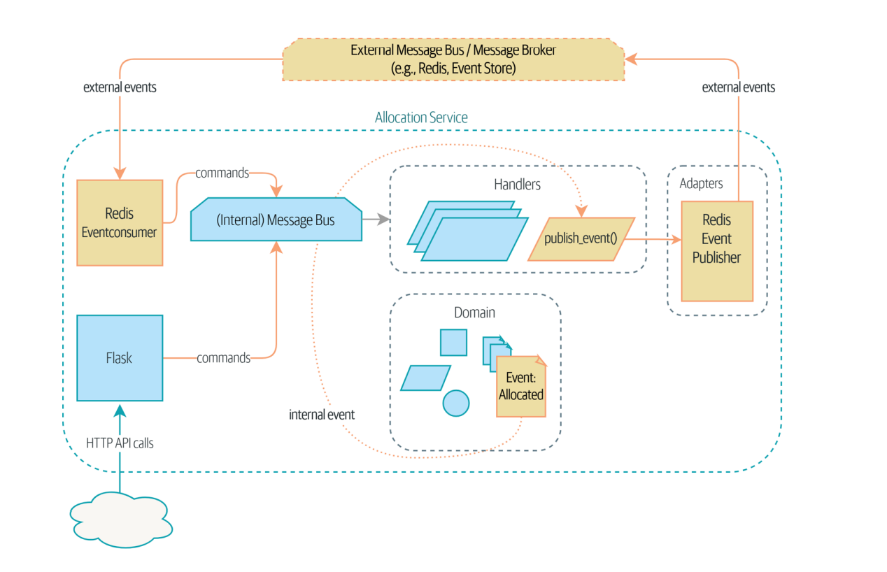

Slide 69
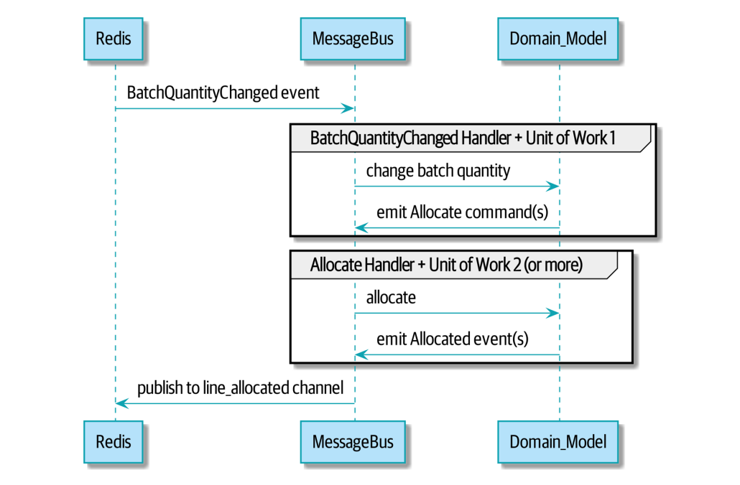
Using a Redis Pub/Sub Channel for Integration This piece of infrastructure is often called a message broker. The role of a message broker is to take messages from publishers and deliver them to subscribers.

Slide 70
Implementation
Our Redis pub/sub listener (we call it an event consumer) link
We also build a new downstream adapter to do the opposite job converting domain events to public events link

Slide 71
Wrap-Up
Events can come from the outside, but they can also be published externally
our publish handler converts an event to a message on a Redis
This kind of temporal decoupling buys us a lot of flexibility in our application integrations
but as always, it comes at a cost
More generally, if you’re moving from a model of synchronous messaging to an async one, you also open up a whole host of problems having to do with message reliability and eventual consistency.

Slide 72
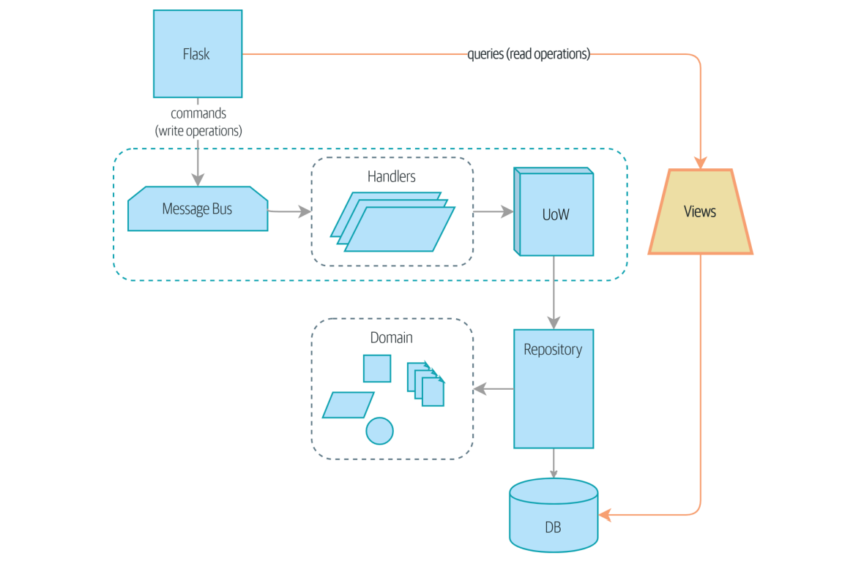
Command-Query Responsibility Segregation (CQRS) reads (queries) and writes (commands) are different, so they should be treated differently.

Slide 73
provide a new read-only endpoint to retrieve allocation state link
We’ll still keep our view in a separate views.py module link link
Splitting out your read-only views from your state-modifying command and event handlers is probably a good idea, even if you don’t want to go to full-blown CQRS.

Slide 74
Chapter 13: Dependency Injection (and Bootstrapping)
We’ll also add a new component to our architecture called bootstrap.py; it will be in charge of dependency injection, as well as some other initialization stuff that we often need.

Slide 75
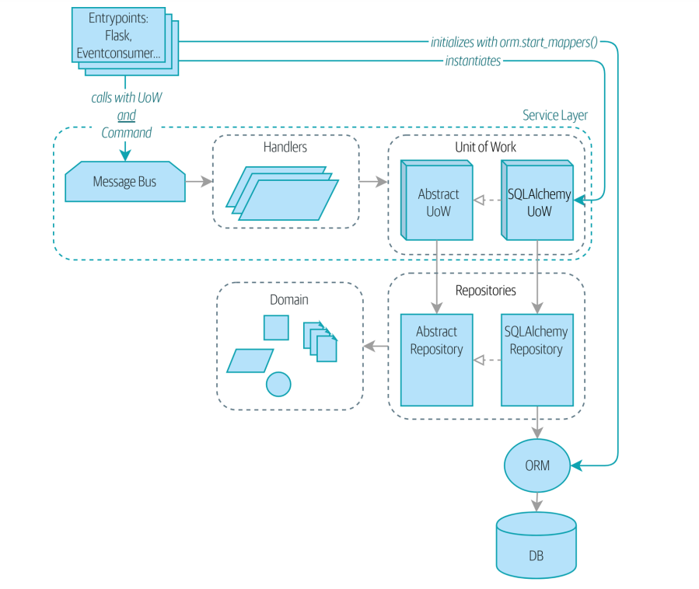
Figure below shows what our app looks like without a bootstrapper: the entrypoints do a lot of initialization and passing around of our main dependency, the UoW.

Slide 76
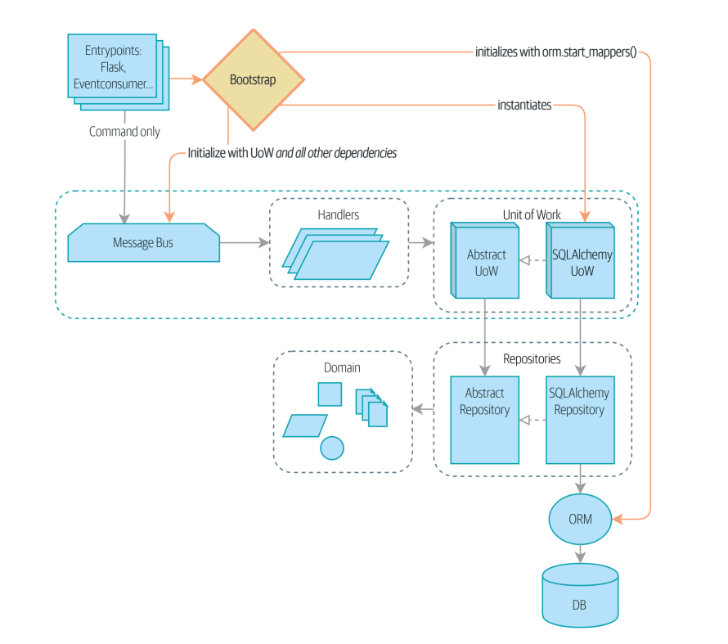
Figure below shows our bootstrapper taking over those responsibilities.

Slide 77
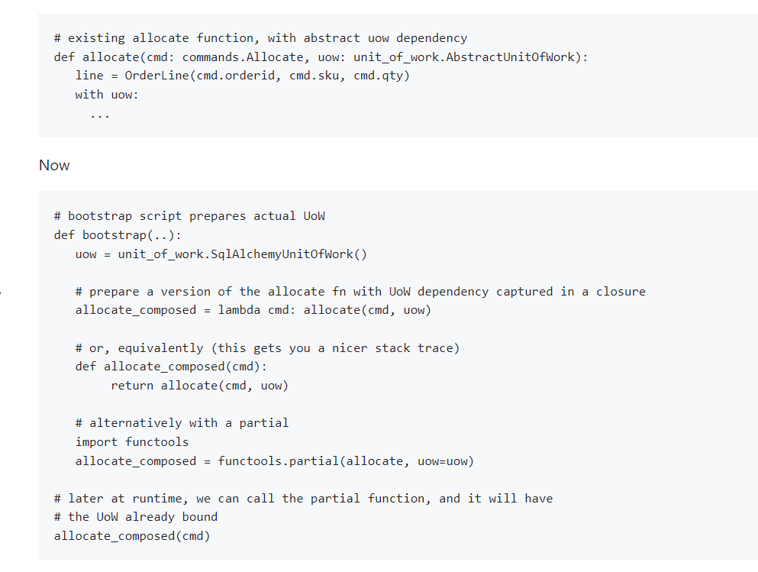
Dependency injection with Closures and Partials

Slide 78
A Bootstrap Script link
1- Declare default dependencies but allow us to override them
2- Do the “init” stuff that we need to get our app started
3- Inject all the dependencies into our handlers
4- Give us back the core object for our app, the message bus

Slide 79
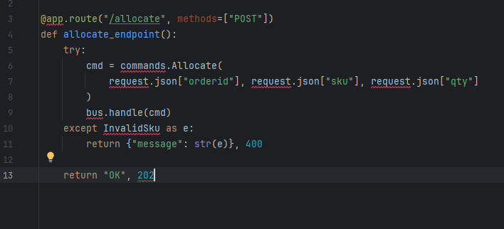
Using Bootstrap in Our Entrypoints

Slide 80
